Slide 1
Introduction to Tableau
Part 12
Notes:
Welcome back to Data Society! We have a great class ahead of us today.

Slide 2
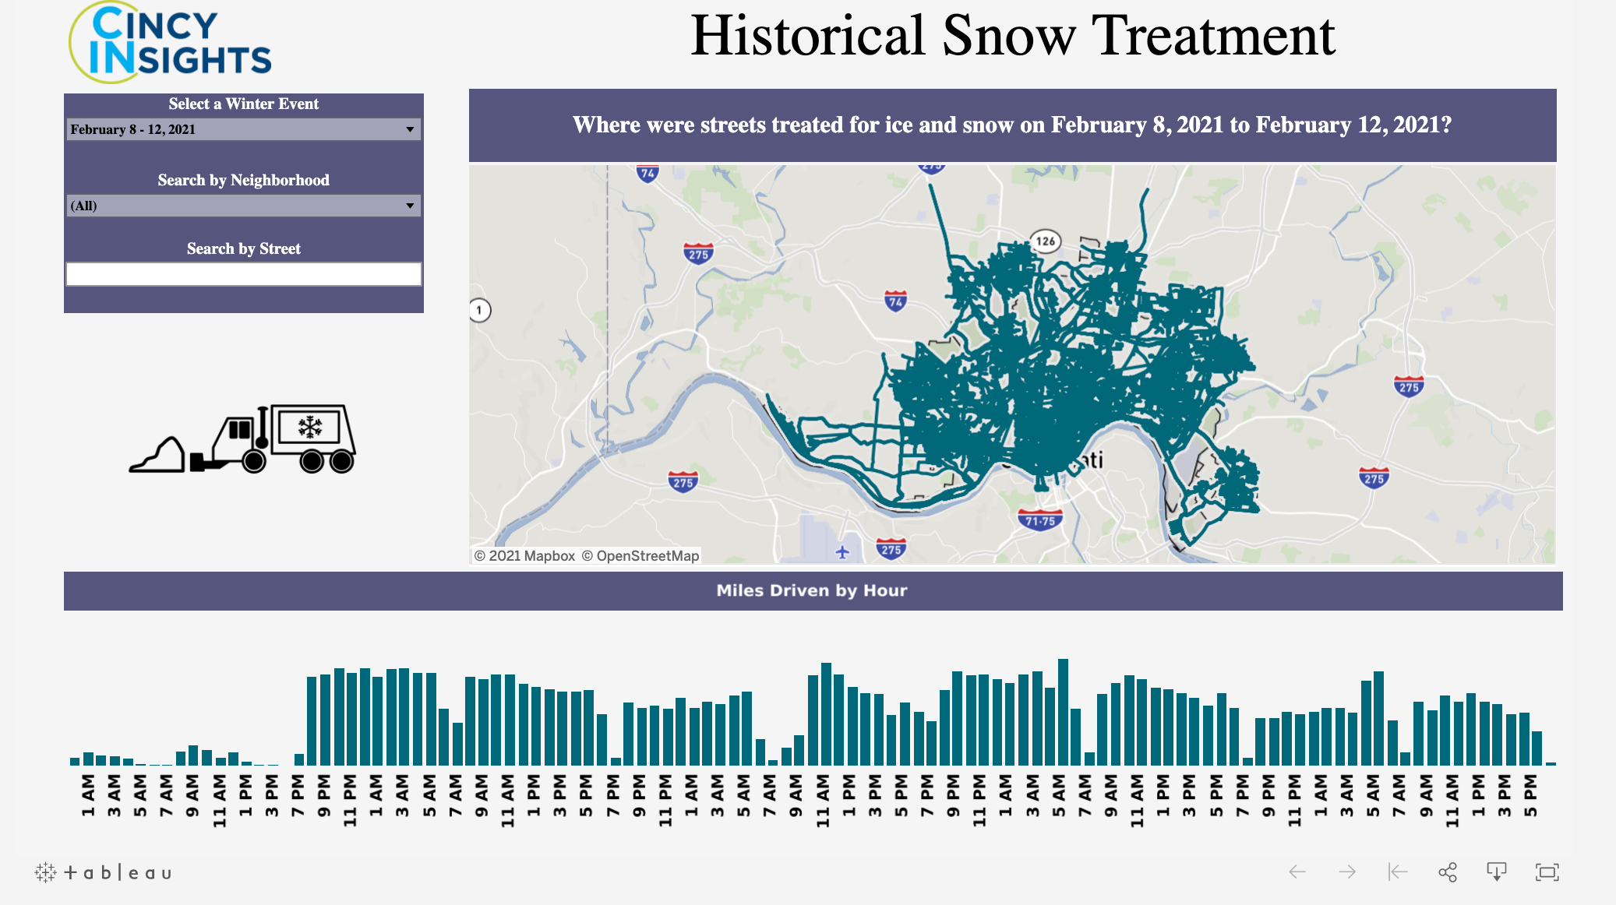
Warm-up: Cincinnati snow tracker
The city of Cincinnati built a snow plow tracker map to allow the public to see what parts of the city have been plowed out in a given weather event.
Spend a few minutes exploring and evaluating the tool, then be prepared to comment on what you like and what could be improved in the design.
Cincinnati Snow Tracker (link)
Notes:
The purpose of this slide is to get students thinking about geospatial data (and dashboards) as subject to revision. Give students 5-7 minutes to explore the tool. ASK for students to comment on the design, both positively and negatively, and COMMENT on their critiques and suggestions.

Slide 3
Module completion checklist
Objective | Complete
Introduce the concept of geospatial visualization
Implement geospatial visualization for given dataset
Identify and correct errors to facilitate proper joining with geospatial data
Introduce the concept of Dashboards
Combine previously created visualizations into Dashboard

Slide 4
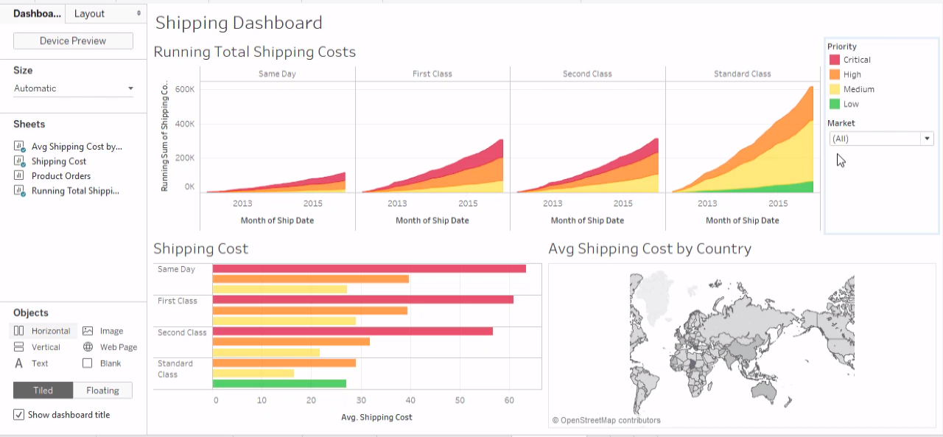
Dashboards and stories
A dashboard is a panel with a group of objects with a common theme.
A story is a linear plot of related dashboards.
Interactive and multi-part.
Size and shape can be customized.
Notes:
The purpose of this slide is to introduce how dashboards and stories relate to one another in Tableau.

Slide 5
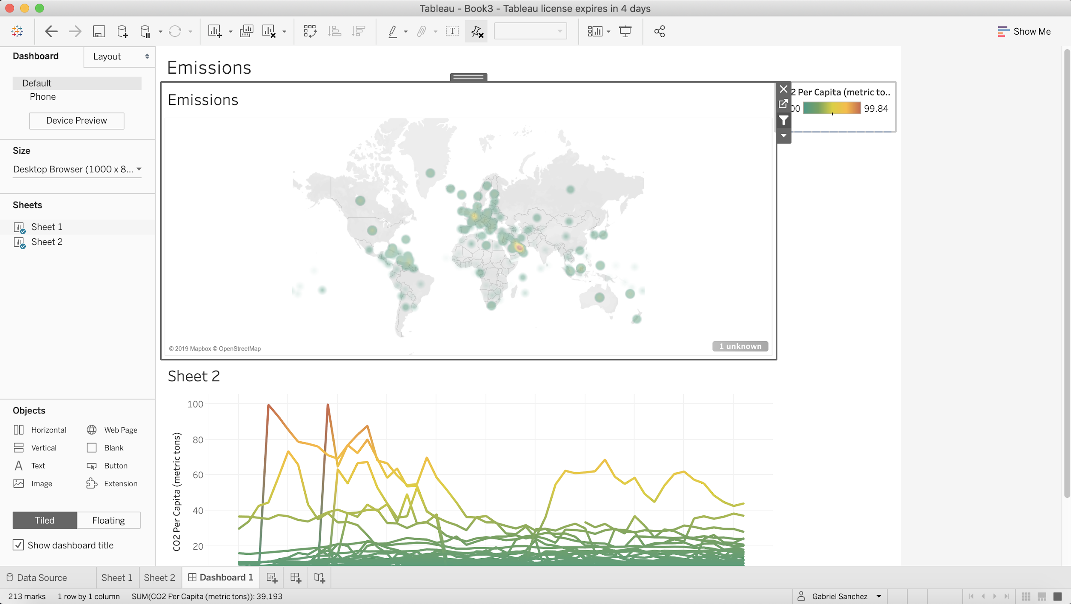
Creating a new dashboard
New Dashboard Button
Notes:
The purpose of this slide is to show how to create a new dashboard and add the sheets we have created into it
To create a dashboard, Click on the dashboard icon at the bottom of the display, and then check the Sheets you would like to add into the dashboard. Since we have 2 sheets in the above screenshot, both of them appear in the list of sheets that are available.
Feel free to explore the sheets you have created so far and start creating your dashboard and add the sheets to it.

Slide 6
Best practices for dashboards
Know your purpose and audience.
Leverage the most-viewed spot.
Be mindful of your final display size.
Limit the number of views.
Be security-savvy.
Add interactivity to encourage exploration.
Show filters.
Enable highlighting.
Notes:
The purpose of this slide is to lay out some best practices for building dashboards in Tableau. EXPAND on each of the bullets in the list on the left and EXPLAIN their importance. SIGNAL to students that this is just a preliminary introduction to concepts we will discuss in more detail during the Storytelling in Tableau portion of the course.

Slide 7
Module completion checklist
Objective | Complete
Introduce the concept of geospatial visualization
Implement geospatial visualization for given dataset
Identify and correct errors to facilitate proper joining with geospatial data
Introduce the concept of Dashboards
Combine previously created visualizations into Dashboard

Slide 8
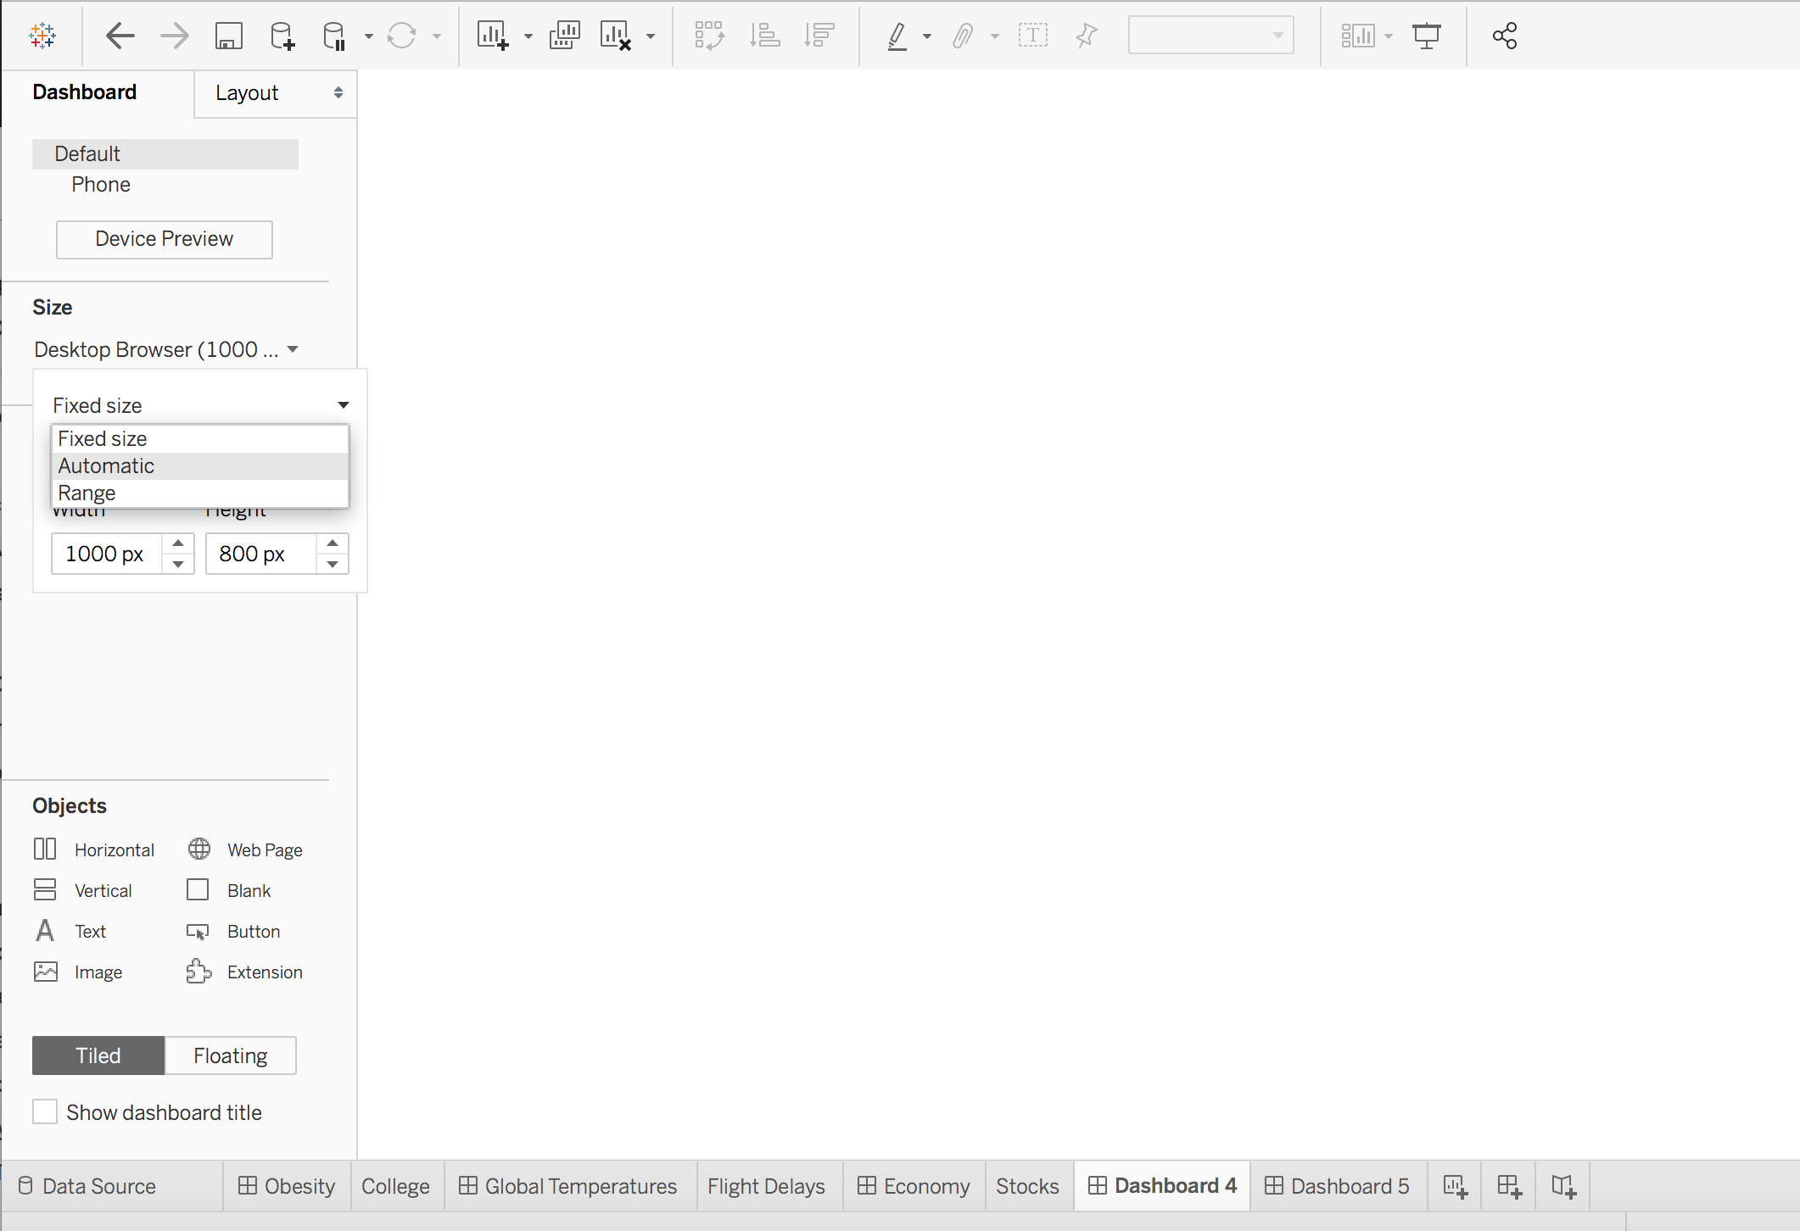
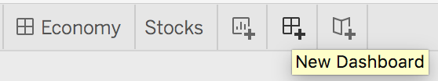
Dashboard implementation
Add a dashboard by clicking on the tab at the bottom.
Consider the size of the final dashboard.
Fixed
Automatic
Range (manual)
Consider the purpose of the dashboard.
Is this for a mobile device?
Will it be used on a large monitor?
Notes:
The purpose of this slide is to WALK THROUGH how to implement a new dashboard in Tableau, as well as offering some basic considerations to keep in mind (size / purpose) while constructing one.

Slide 9
Building your first dashboard
Use the plots you have been making and saving with the world dataset to create a dashboard.
Feel free to focus on just a subset of variables and choose the visualizations that you think are most interesting.
Use the best practices for Dashboards to guide you in your choice.
Notes:
The purpose of this slide is to direct students to create a dashboard using the world dataset. REMIND students that they have been saving their work all along so that they have many different charts to choose from. ENCOURAGE students to experiment -- the purpose right now is to make something functional, not something perfect. SUGGEST they try to keep the best practices in mind.

Slide 10
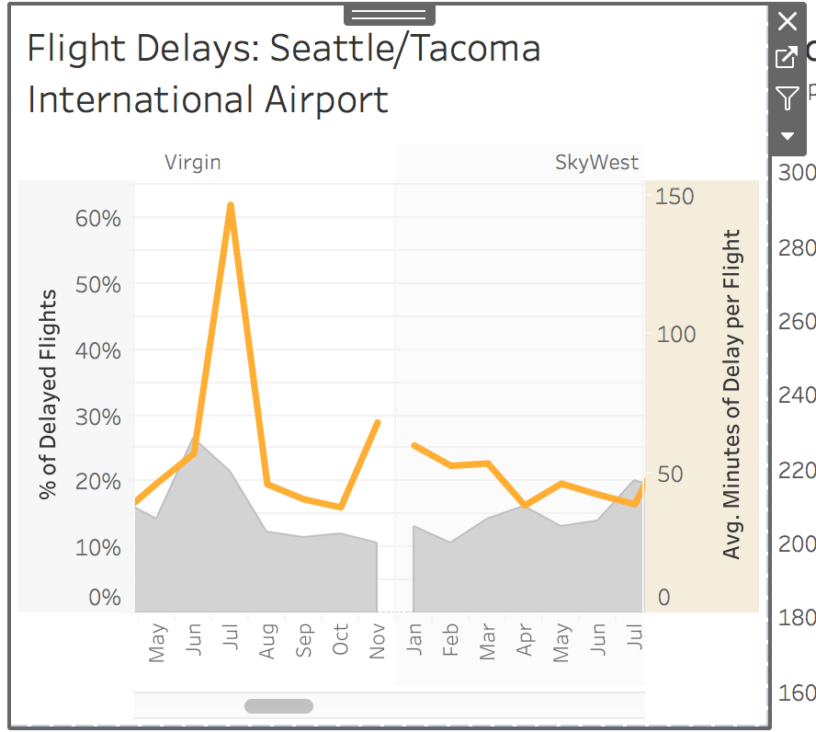
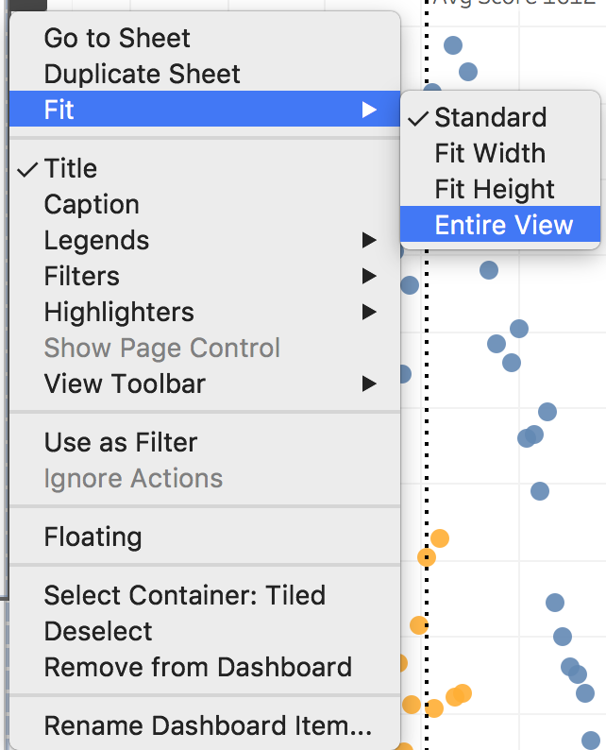
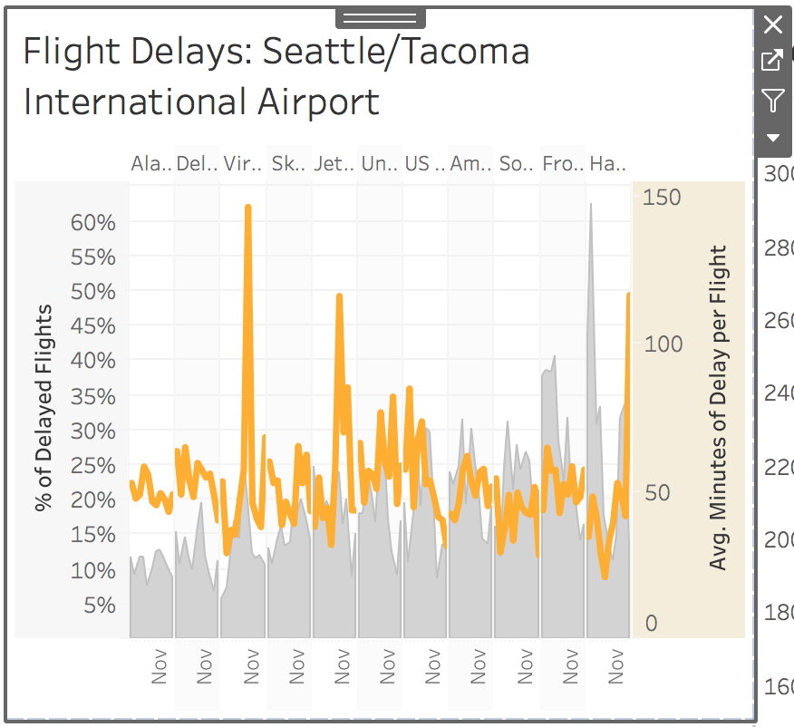
Sheet dropdown menu options
Fit options
Fix issues with out-of-frame sheets
Filter options
Title options
Notes:
The purpose of this slide is to present some of the options available in the dropdown menu for each sheet in a dashboard. EXPLAIN what choices are available in terms of fit, filter, and title.

Slide 11
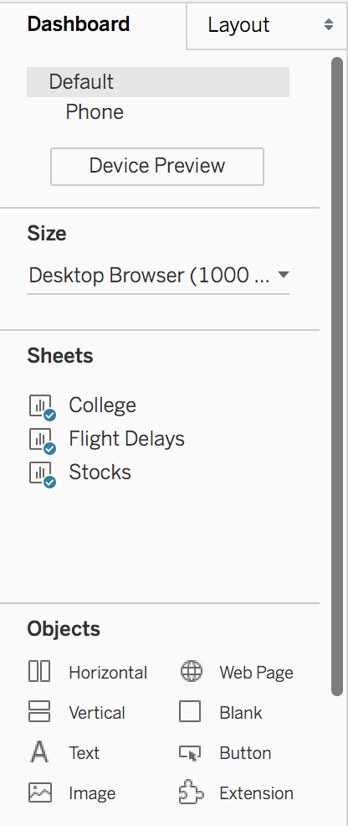
Objects and containers
The Dashboard menu can add objects and containers.
Containers hold items and scale them together.
You can also add other kinds of objects:
Web pages.
Blank spacers.
Images.
Text.
Extensions.
Buttons.
Horizontal or vertical container
Notes:
The purpose of this slide is to introduce the Dashboard menu, and to explain how to partition sheets using horizontal and vertical containers. ENCOURAGE students to try applying these formatting features to their practice dashboard.

Slide 12
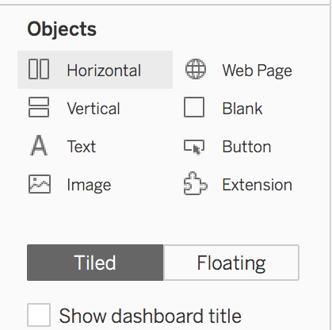
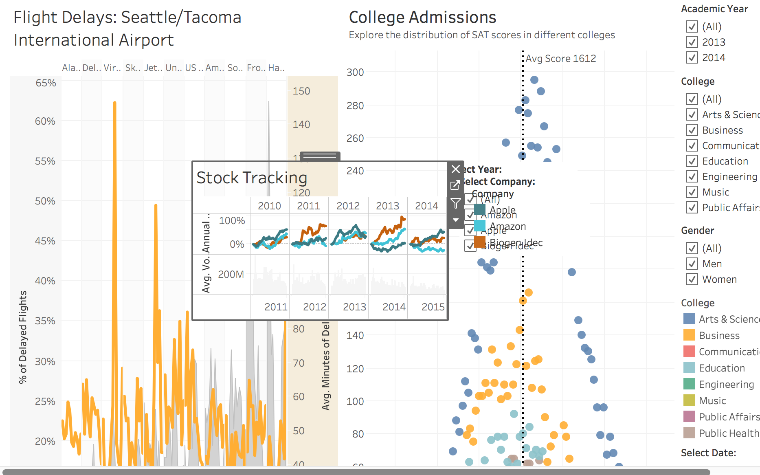
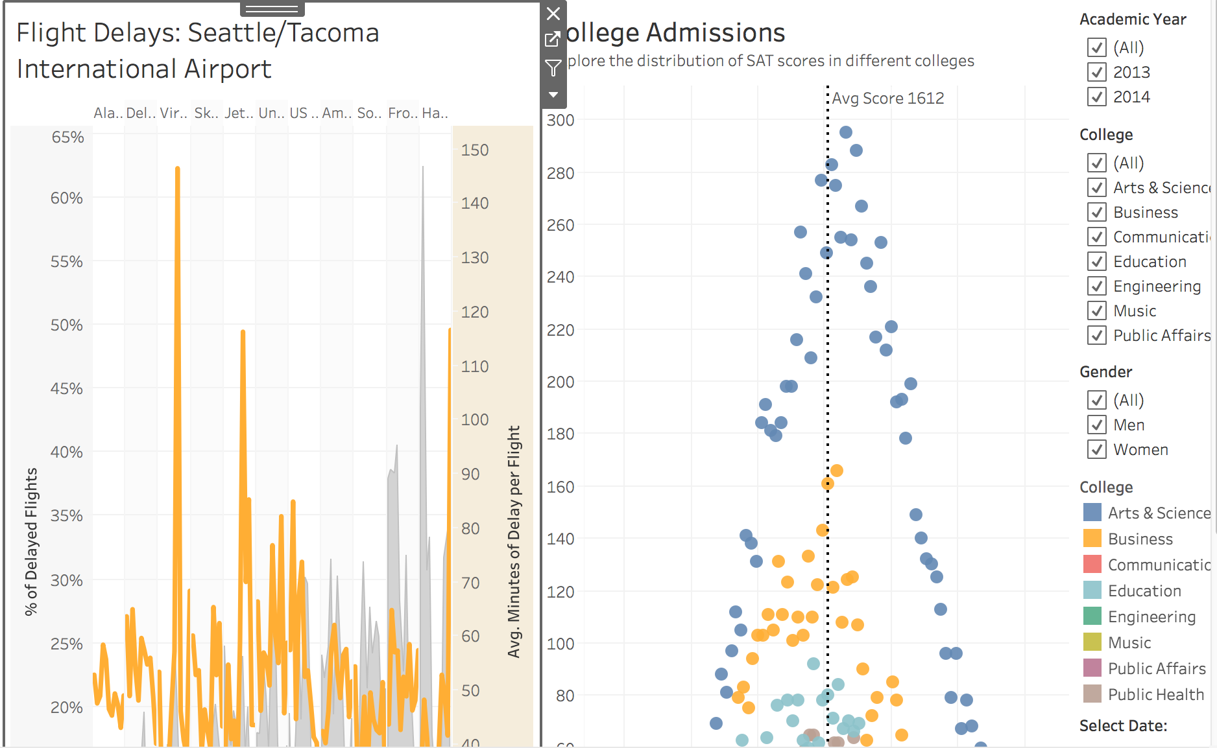
Tiled vs. floating elements
Each object or layout container can be either tiled or floating.
Different effects on shape and sizing.
Tiled
Arranged in a single layer grid.
Adjust in size based on the total dashboard size and other objects.
Floating
Layered on top of other objects.
Can have a fixed size and position.
Notes:
The purpose of this slide is to explain the distinction between adding tiled and floating elements. WALK THROUGH some use-cases for each kind of data format within a given dashboard.

Slide 13
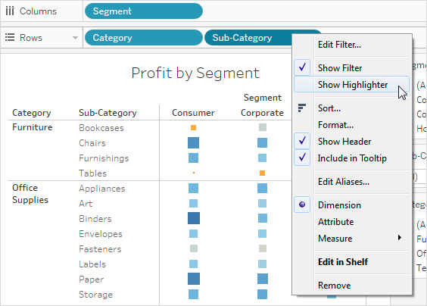
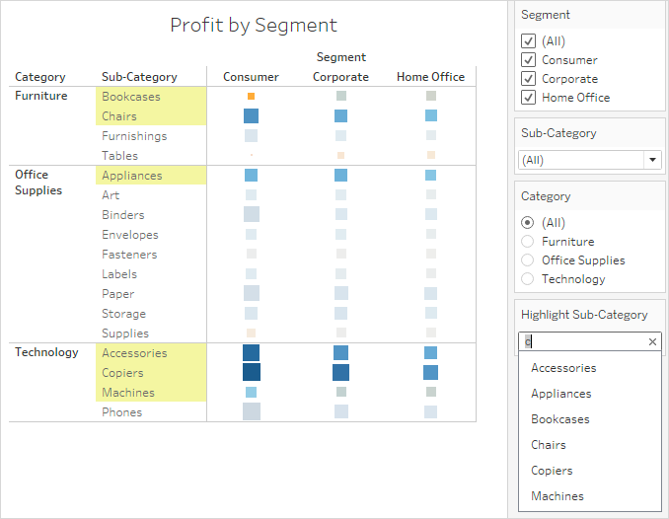
Highlighting
You can use the Highlight button on the toolbar to set up highlighting between views.
When highlighting is turned on, a filtered selection in one view will highlight related data in the other views.
You can turn on highlighting for all fields or select specific fields.
Notes:
The purpose of this slide is to explain how highlighting in Tableau relates to the filter settings.

Slide 14
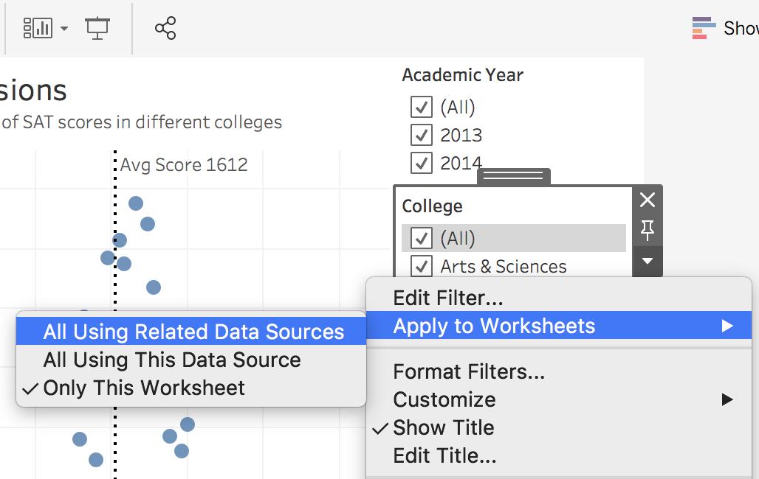
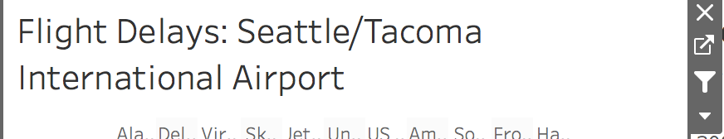
Couple filtering
If your dashboard panels share data you might want to enable couple filtering to apply a filter across the whole dashboard.
Couple filtering can be enabled using two options:
Option 1: Filter panels, as on the right.
Option 2: Clicking the Filter on a given sheet, which will use it to filter other sheets.
Notes:
The purpose of this slide is to explain how to link related data sources via filtering, allowing for global output changes within the dashboard space. DEMONSTRATE an example of linking filters together by each method listed on the slide, and MANIPULATE the visualization accordingly.

Slide 15
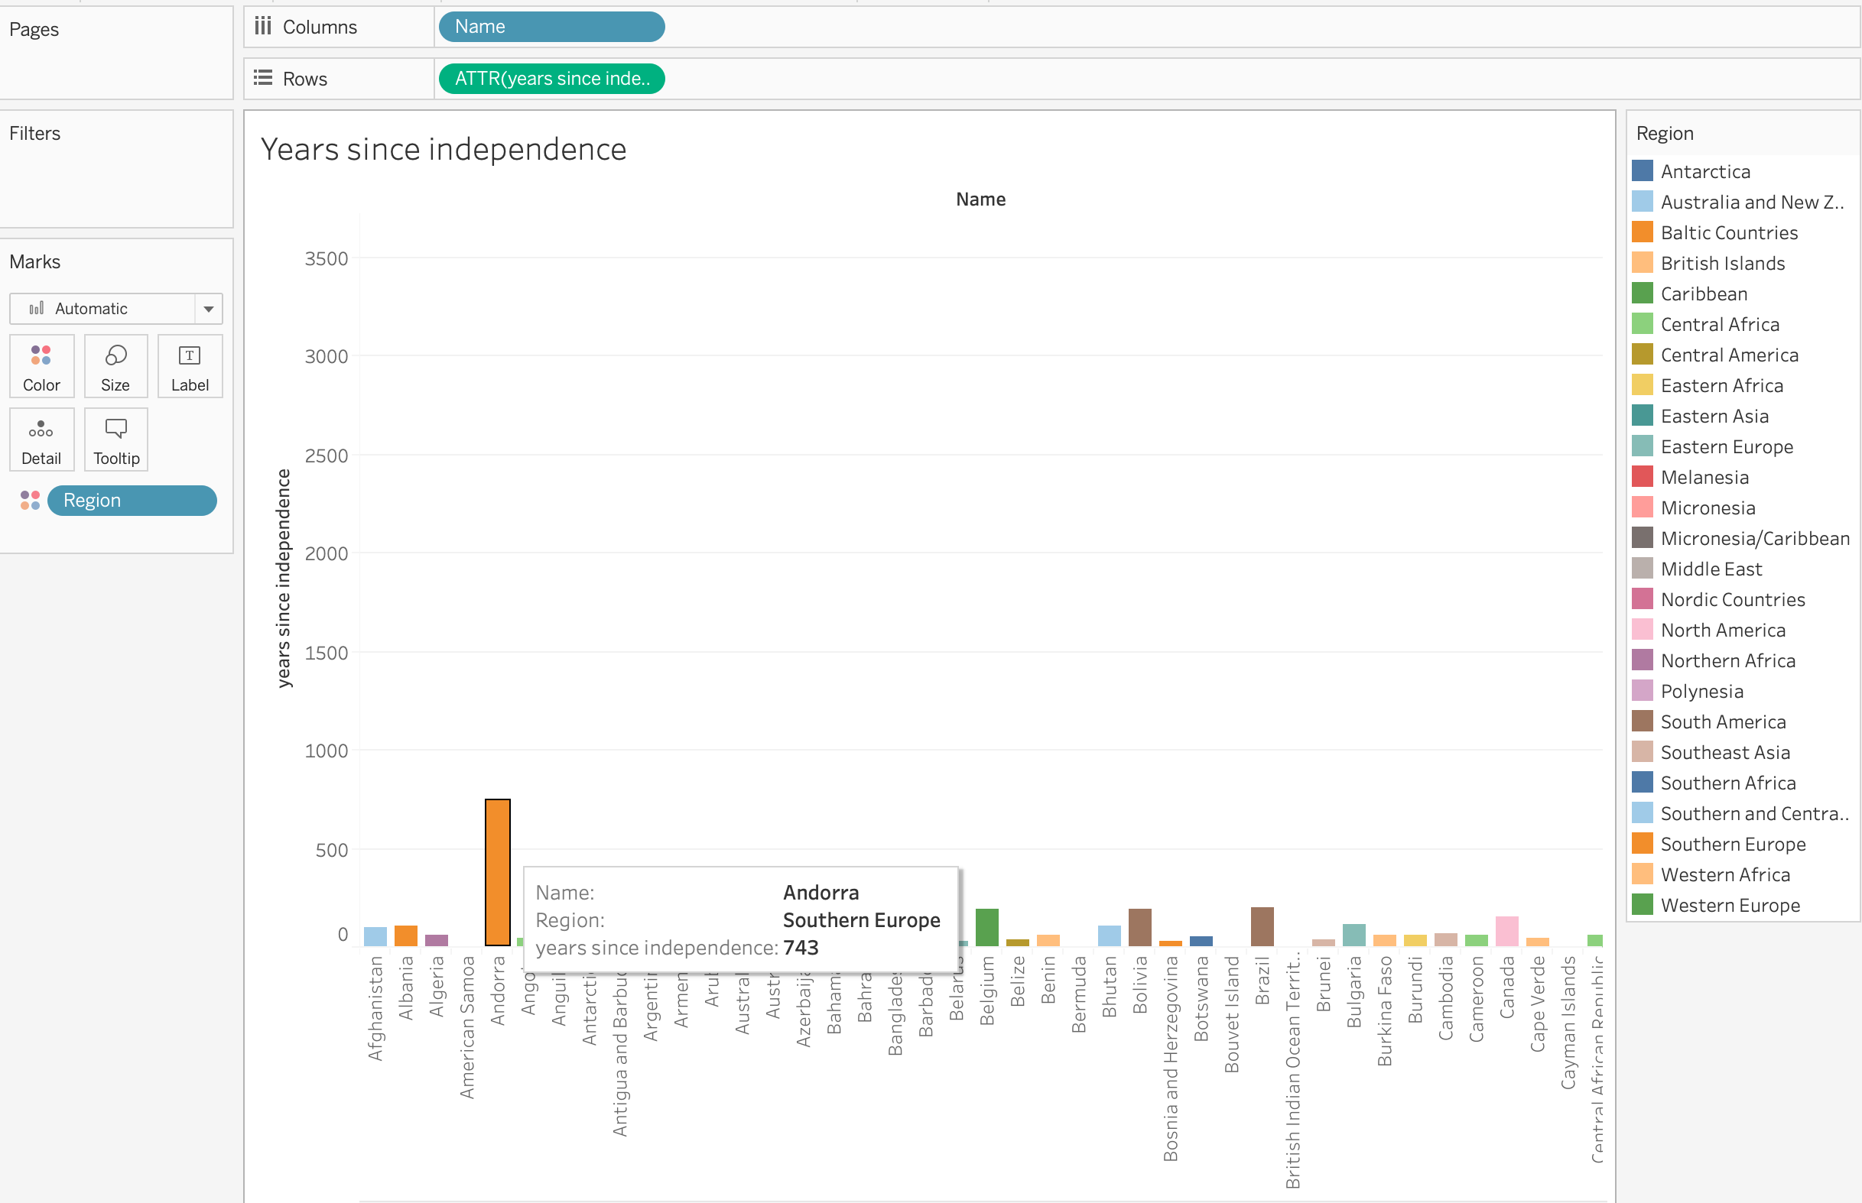
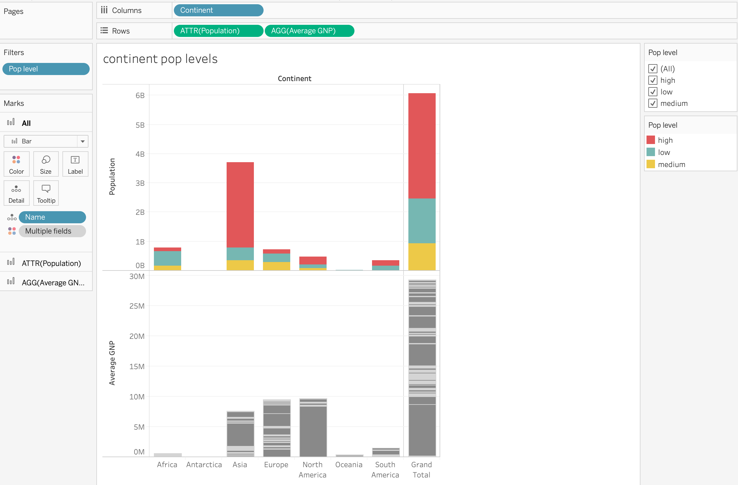
Inspiration from previous modules
To practice using multiple filters, let’s revisit some charts we have built.
Notes:
The purpose of this slide is to invite students to use two of the charts they should have saved from last week’s class (Day 6) to practice using multiple filters in a dashboard. REMIND students that the visualizations in question are:
LEFT: a bar chart to show the countries along with their years of independence
RIGHT: bar charts to show the population and Average GNP of the countries based on population levels
NOTE: If they haven’t already done so, students must add the filter on the population level for the continent population level chart.

Slide 16
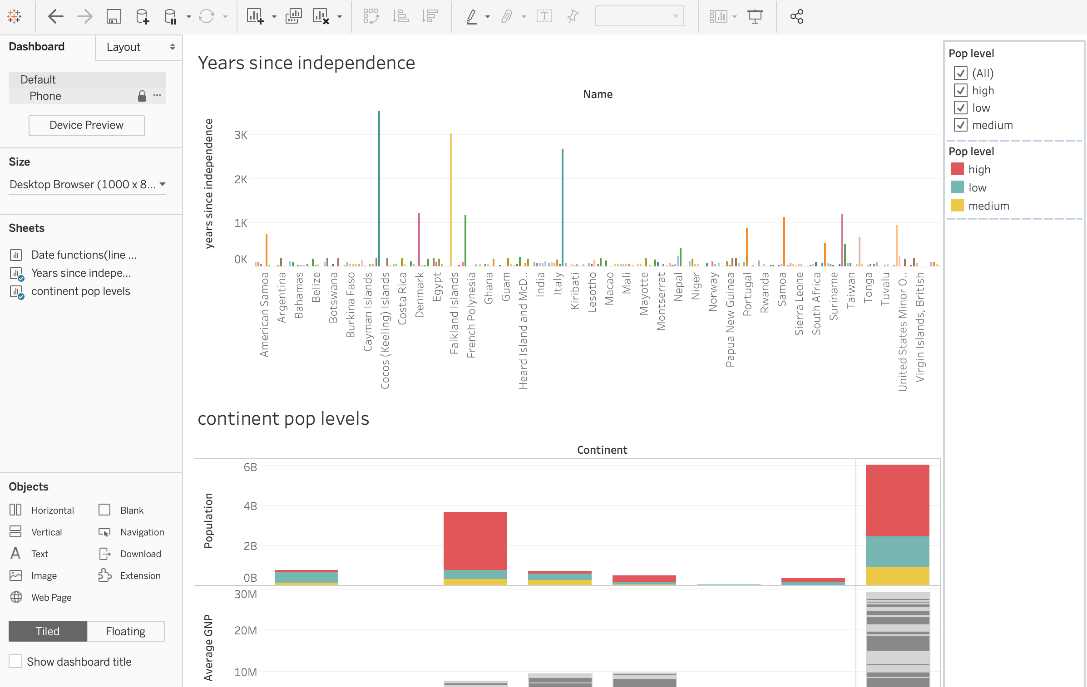
Add charts to dashboard
Notes:
The purpose of this slide is to show what a dashboard containing the two sheets mentioned in the previous slide might look like.

Slide 17
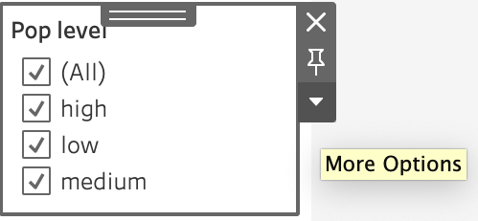
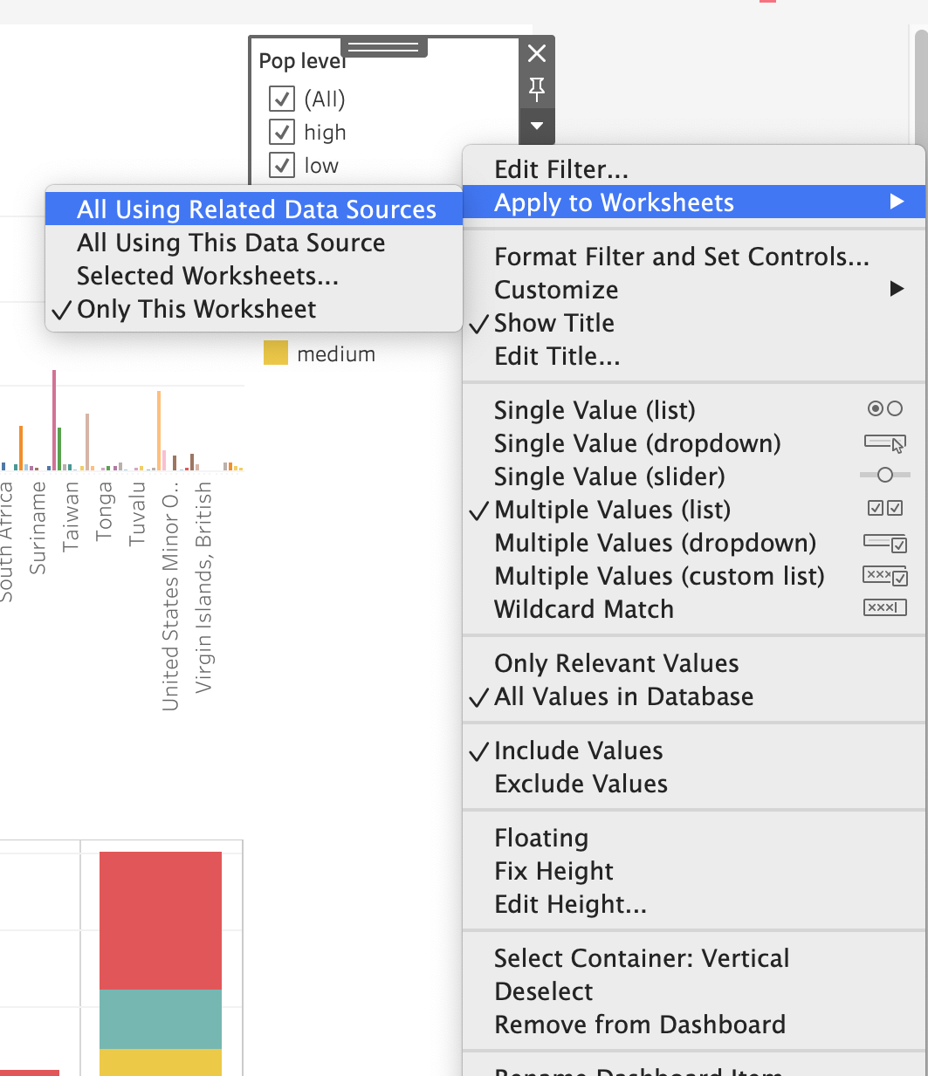
Couple filtering: option 1
At this point, the pop level filter on the dashboard only applies to the continent pop level chart.
To apply this filter to the years since independence chart:
Select the Pop level filter.
Click on the “More Options” dropdown menu
Select “Apply to Worksheets” -> “All Using Related Data Sources.”
Now when you select an option in the Pop level filter, both charts are updated.
Notes:
The purpose of this slide is to describe the first couple filtering option, by applying a filter created for one chart to another chart related by a shared data source. WALK THROUGH the procedure outlined on the slide.

Slide 18
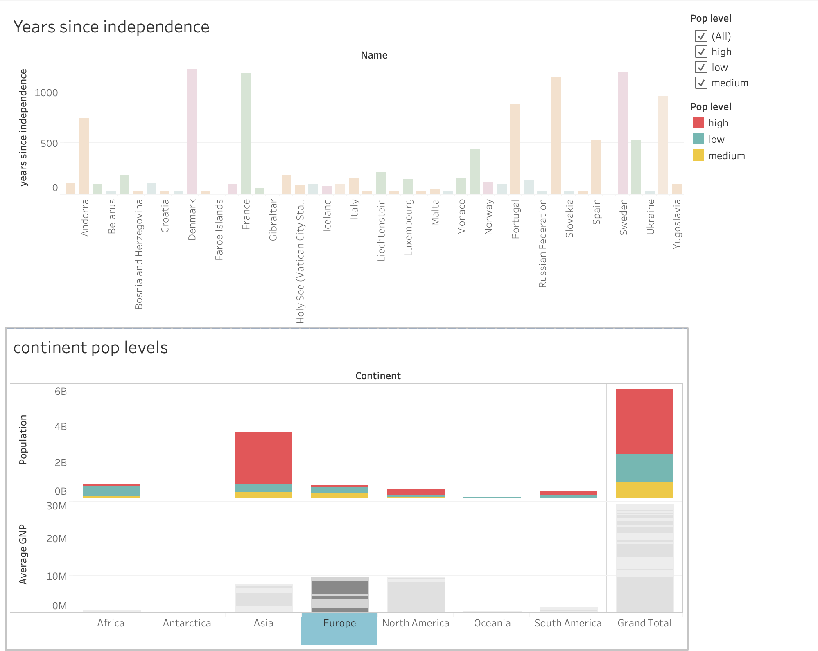
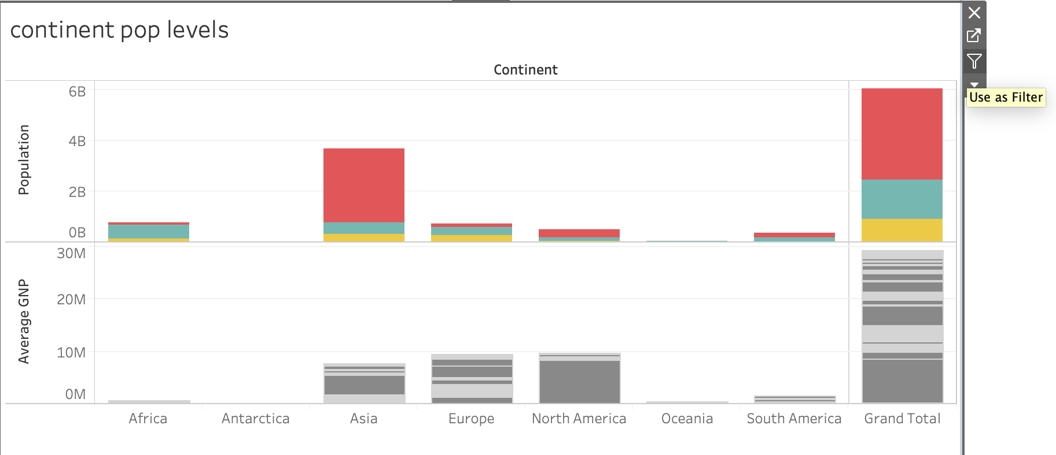
Couple filtering: option 2
You can also use a chart in your dashboard as a filter.
Select the chart and click on the filter icon to the right.
Now if we select “Europe” from the pop levels chart, you can see that the years since independence chart updates, too.
Notes:
The purpose of this slide is to describe the second couple filtering option, using an entire chart as a filter for the dashboard. WALK THROUGH the procedure described on the slide.

Slide 19
Knowledge check 12

Slide 20
Exercise 12

Slide 21
Module completion checklist
Objective | Complete
Introduce the concept of geospatial visualization
Implement geospatial visualization for given dataset
Identify and correct errors to facilitate proper joining with geospatial data
Introduce the concept of Dashboards
Combine previously created visualizations into Dashboard

Slide 22
Congratulations!
In the past few modules, we covered:
Defining geospatial visualization
Generating coordinates
Cleaning and fixing geospatial data
Creating a final dashboard
Notes:
The purpose of this slide is to review the various topics covered in class today. It is also an opportunity to ASK if students have any outstanding questions that need to be resolved.

Slide 23
End of Part 12

Slide 24
Congratulations!

